Slide 1

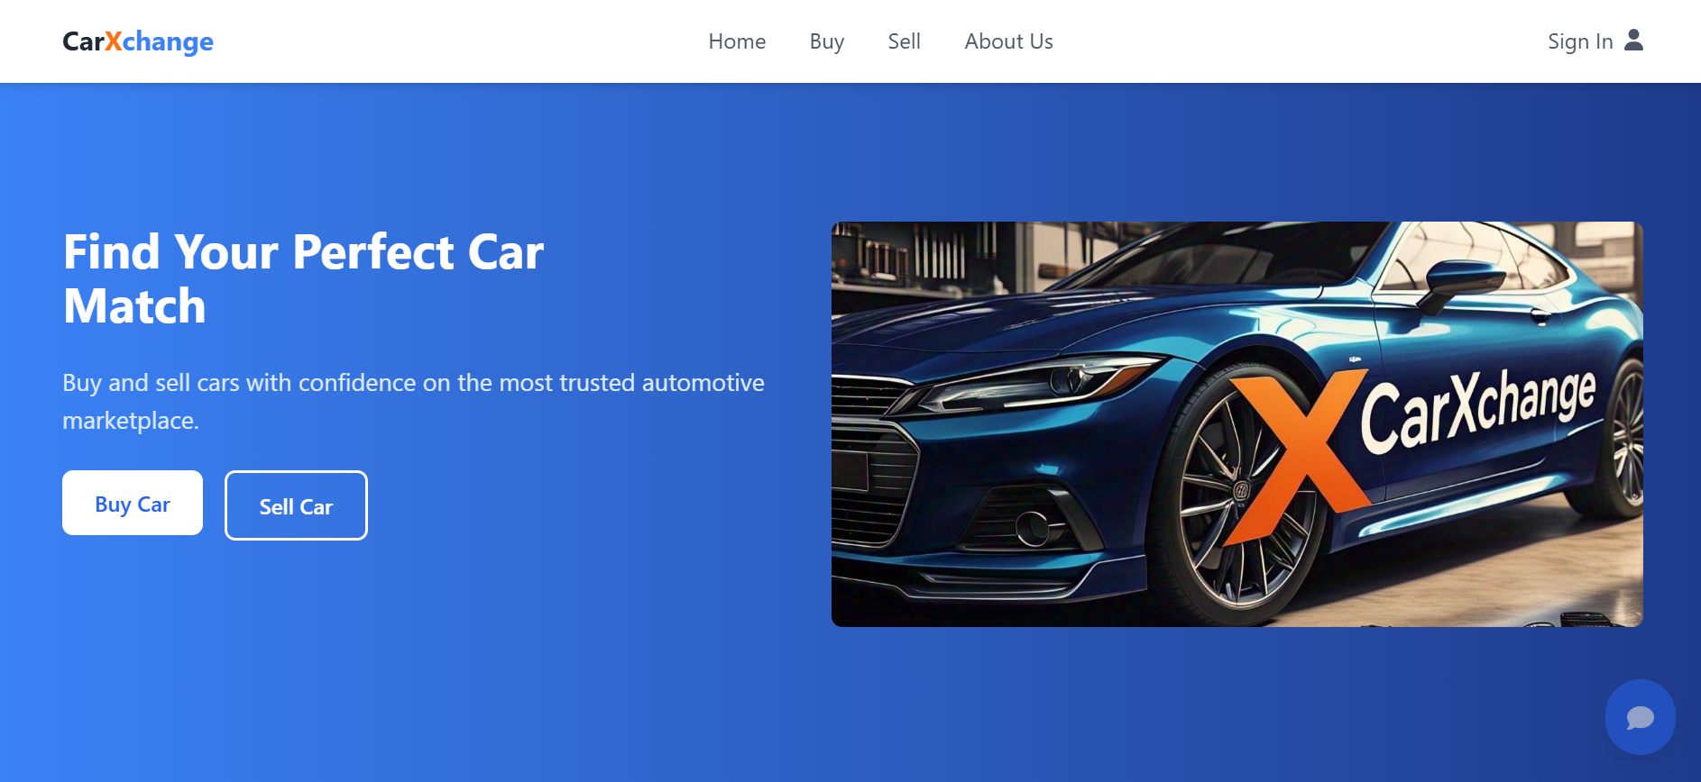
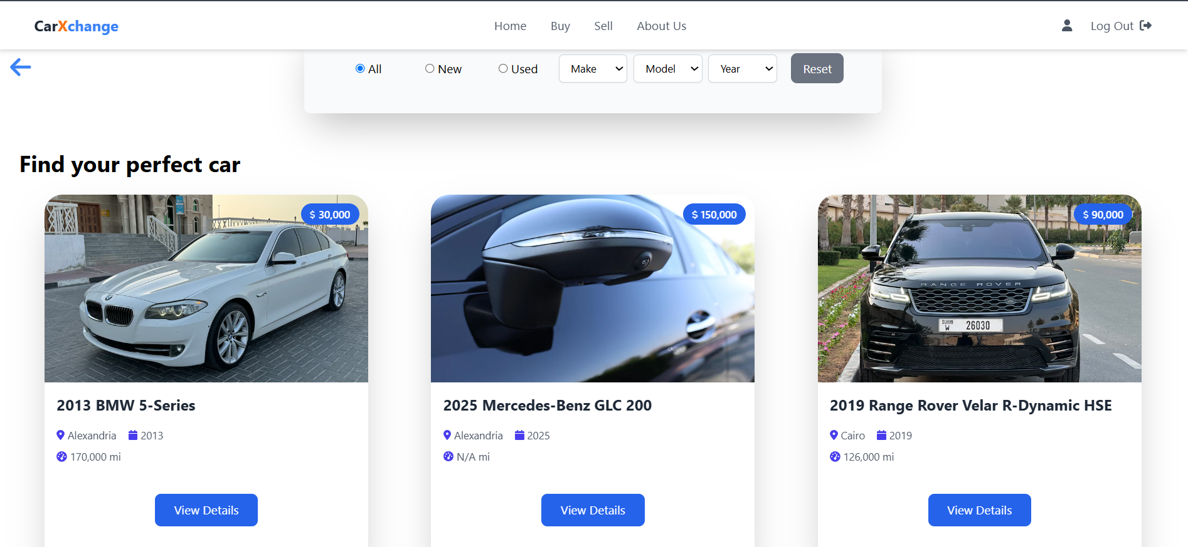
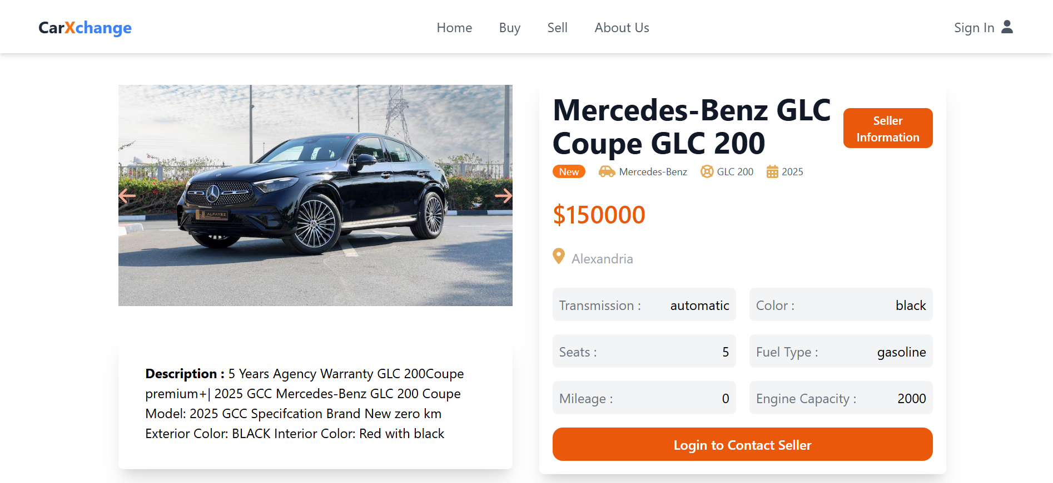
Computer Science and Engineering
Course name : Web Programming
CarXchange
Team : Malak yasser , Omar Ashraf , Faress hassan
Problem
Traditional car buying/selling lacks transparency and efficiency.
Limited options and communication barriers between buyers and sellers.
Buyers can't easily find good local deals
Buyers need instant answers to car-related questions.
Goal
Develop CarXchange, an online platform for buying/selling cars.
Provide real-time listings with search/filtering options.
Ensure secure communication between users.
Provide real-time, AI-powered car expertise via 24/7 chatbot to educate buyers/sellers.
Approach
Technologies used
• Designed an intuitive interface for easy navigation.
• Implemented secure user authentication and verification
• Smart search filters for buyers
Implemented AI-powered chatbot for real-time car advice
Frontend: HTML, CSS, Tailwind, JavaScript, React.js
Backend: Node.js, Express.js
Database: MongoDB
Tools: Postman (for API testing),
Results and Conclusion
Successfully deployed a functional platform with user authentication, car listings, and filter features.
The easiest way to buy or sell your next car – no fees, no hassle.
We're changing how people buy and sell cars - making it faster, safer, and more transparent for everyone.
our dedicated car expert chatbot provides instant answers to vehicle questions

